Slide 1
Infuse AI in your Windows apps with Windows Copilot Runtime and .NET
Nikola Metulev
@metulev

Slide 2
Windows Copilot Runtime
Applications + Experiences
Windows Copilot Library + On-device models
AI frameworks + toolchain
Silicon

Slide 3



















Applications and Experiences built using the Windows Copilot Runtime
Applications + Experiences
Windows Copilot Library + On-device models
AI frameworks + toolchain

Slide 4
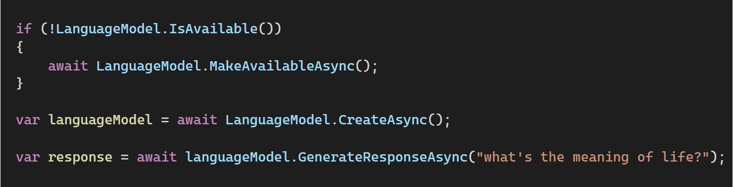
Windows Copilot Library
Applications + Experiences
Windows Copilot Library + On-device models
APIs backed by on device ML models
AI frameworks + toolchain
Phi Silica and Text Recognition will be available in an upcoming WinAppSDK experimental release
Vector Embeddings, RAG, Text Summarization and more will follow

Slide 5


DirectML
Applications + Experiences
Windows Copilot Library + On-device models
AI frameworks + toolchain
High-performance, hardware-accelerated DirectX 12 library for machine learning on Windows
A single, hardware-abstraction API for optimization and deployment, that scales across hardware
Full GPU support and expanding to include NPUs for full breadth of hardware support with AMD, Intel, Nvidia, and Qualcomm
Support for 4-bit Activation-Aware Quantization (AWQ) for minimal impact on accuracy to enable more models across Windows hardware
Available as NuGet package or as part of Windows 10 SDK or newer
DirectML
DirectML graph
Graph compiler
Compiled graph
DDI (device driver interface)
DirectX User Mode Driver (UMD)
DXIL
MCDM/WDDM (KMD)
Native Kernels
NPU
GPU
AI

Slide 6

ONNX, ONNX Runtime (ORT), ORT GenAI, Olive
Applications + Experiences
Windows Copilot Library + On-device models
AI frameworks + toolchain
ONNX = Open and interoperable file format for ML and DNN models.
ONNX Runtime = Fast and efficient model inference and training engine that works across a diverse range of hardware accelerators.
ORT Generate API (ORT GenAI) = High performance, easy-to-use API for GenAI models
Olive = A toolkit for hardware-aware AI model optimization.
`
ONNX Model
In-Memory Graph
Graph Partitioner
Provider Registry
Output Result
Graph Optimization
Input Data
Executor/Graph Runner (Sequential/Parallel)
DirectML
Hardware Accelerators
GPU
NPU

Slide 7
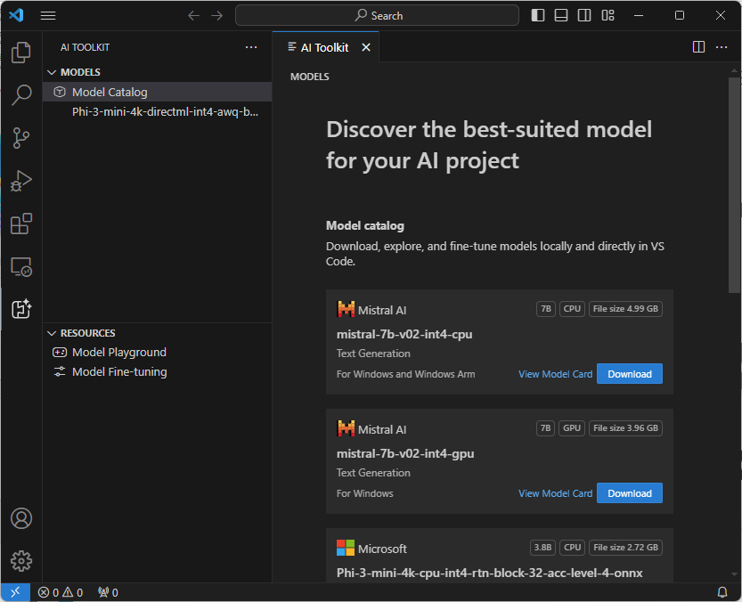
AI Toolkit for VS Code
Applications + Experiences
Windows Copilot Library + On-device models
AI frameworks + toolchain
End-to-end AI Developer toolkit
Download and experiment with Generative AI models, locally
Fine-tune and optimize your model with Olive.
Deploy your AI application and model to the cloud or on-device

Slide 8
aka.ms/wcr
Get started with Windows Copilot Runtime

Slide 9

.NET Conf: Focus on AI
Learn more
aka.ms/dotnetFocusAI/Collection

